Slide 1

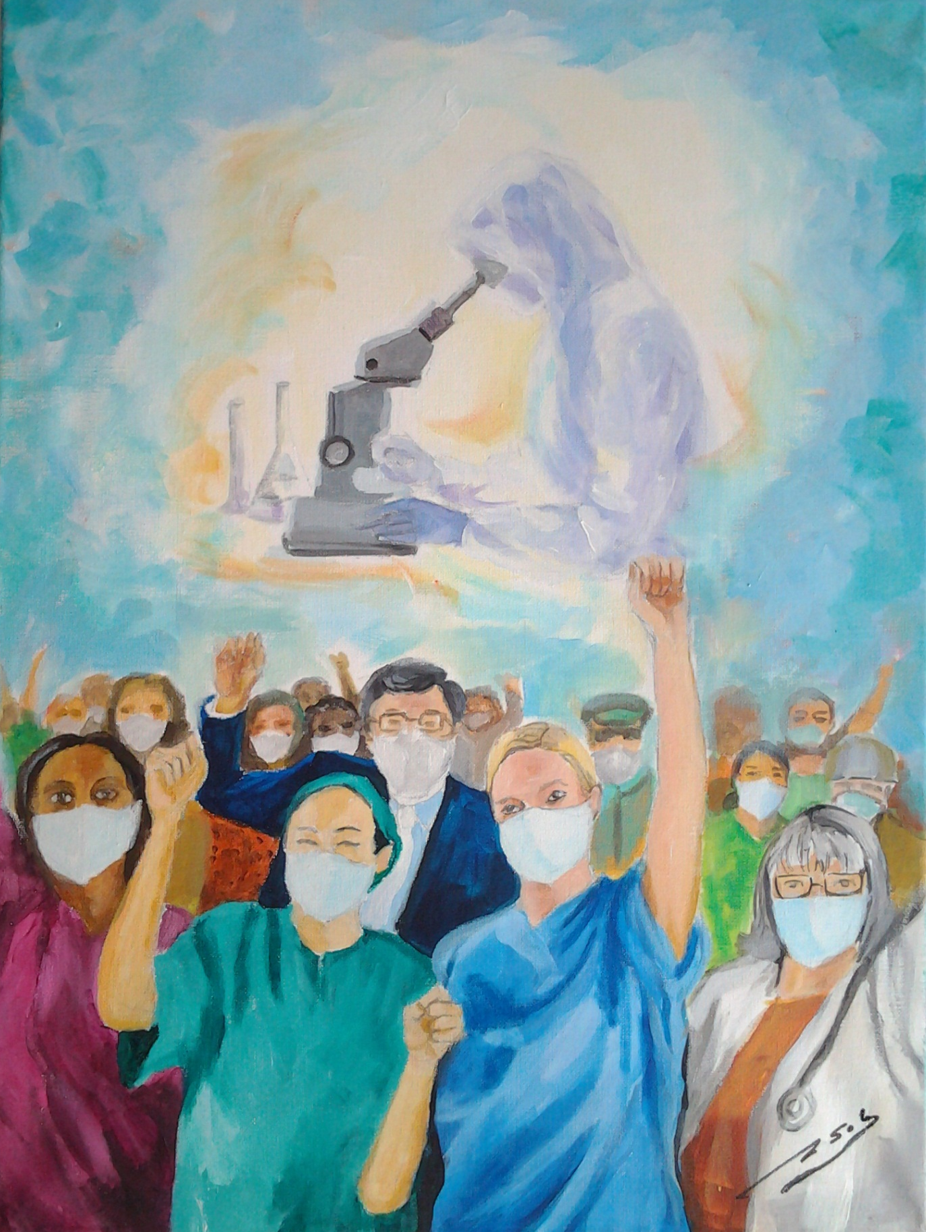
HISPANIC HEALTH PROFESSIONAL ASSOCIATION OF NEW YORK
Together Overcoming Pandemic Barrier
More Information: Dr. Aritmedes Restituyo (732)277-9640
E.Fax(732)725-0868 | info@ahpsi | www.ahpsi.org

